Slide 1
Queen Creek Welcomes you to
A.L.I.C.E.
Training

Slide 2
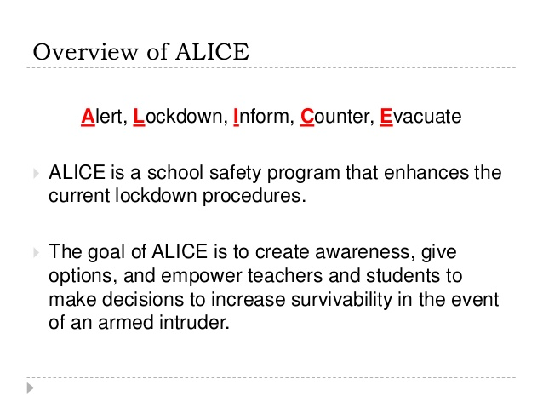
Overview of Alice
Overview of ALICE

Slide 3
A is for ALERT
This is the FIRST notification of danger.
School announcement of a danger on campus
Gunfire, loud noises or screaming
Text alert or phone call
See something say something
NO CODE WORDS

Slide 4
L is for LOCKDOWN
Traditional lockdown procedures PLUS:
Barricade the door (examples on next slide)
Spread out in the room with Counter measures
DO NOT huddle
DO NOT open the door for anyone
Look for alternative exits
Dial 911 if safe to do so

Slide 5
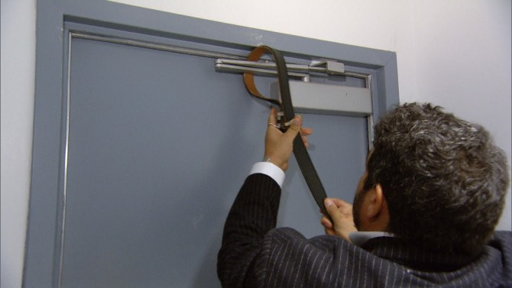
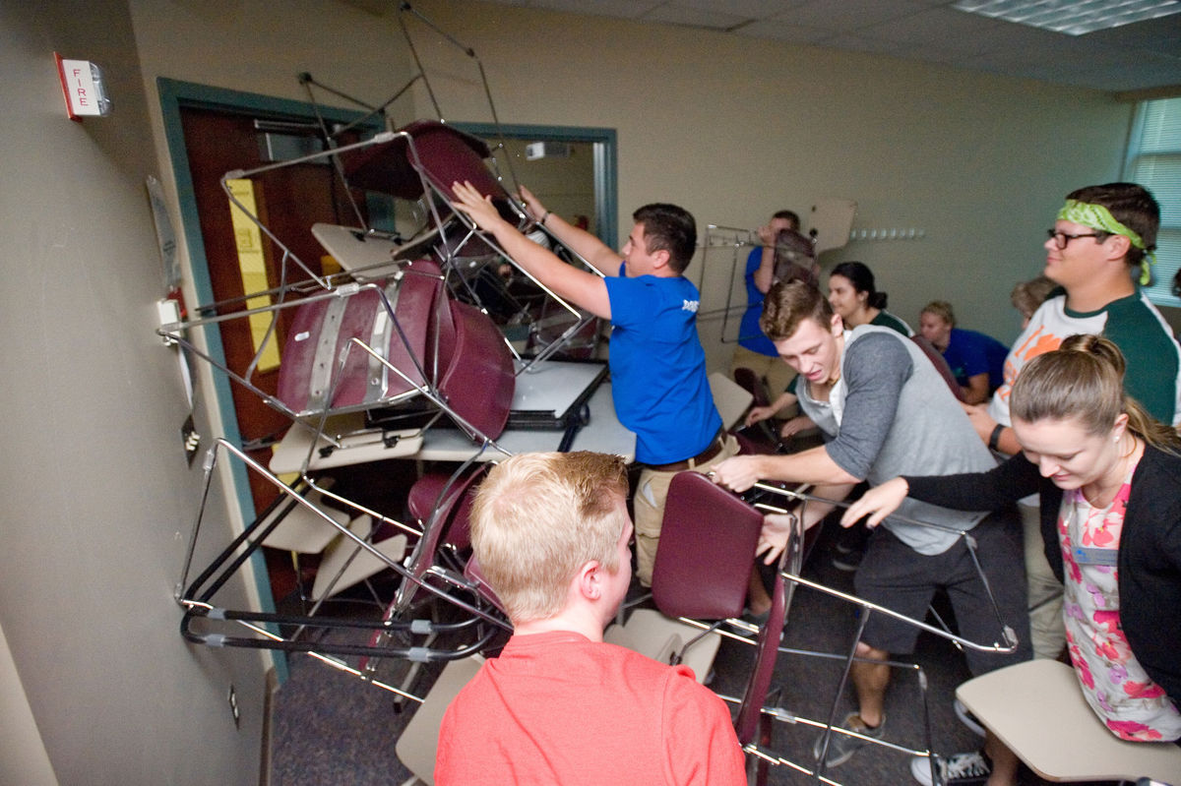
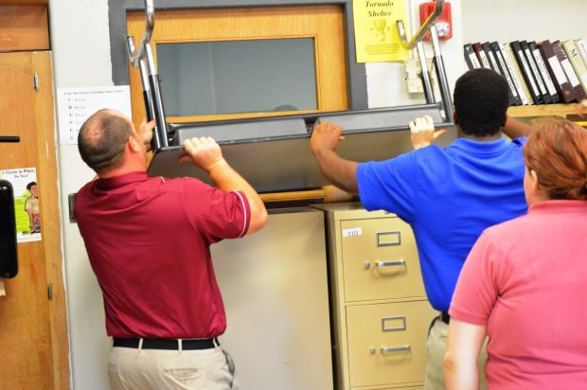
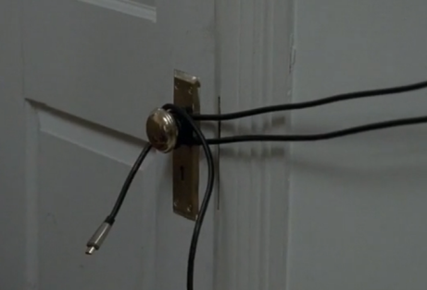
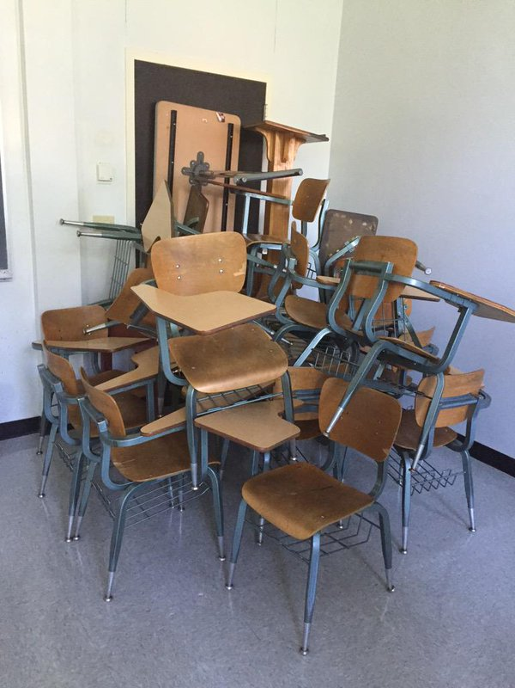
Barricade the door
Barricading the door buys time, and allows you to evaluate the situation.

Slide 6
is for INFORM
Inform can be from students, teachers, administration or any other staff on campus.
Pass on real time information
*What did you see?(Details-what were they wearing, hair color, height, eyes)
*When did you see it? Be specific.
*Where was it?
*Who was it? (man, woman, child…)
*How are they armed?

Slide 7
Counter
What if the barricade doesn’t hold up?
Be prepared to COUNTER
The purpose of COUNTER is to interrupt the intruder
and make it difficult or impossible to aim.
This is a strategy of last resort.
We do NOT physically fight with anyone “dangerous” or an “intruder”

Slide 8
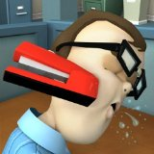
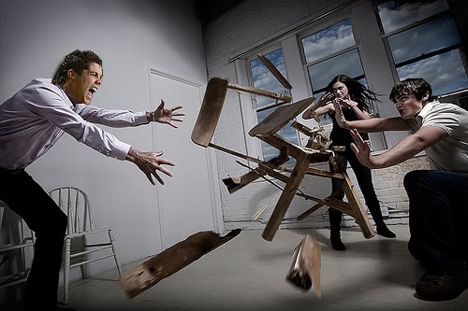
We counter by…
Distracting: screaming, yelling, waving hands, and throwing objects.
Running: Don’t stand still. Constantly move and do what you can to run away and protect yourself.
Be aware of the situation and
work together.

Slide 9
E is for EVACUATE
How do we know if we should stay and barricade or evacuate?
RULE
Never move from a safe area to an unsafe area!
It is important to Stop, Look, and Listen so you can gather as much information as possible before you decide to take any action.
If it is possible to leave the classroom to get away from a “dangerous someone”, we will do so.

Slide 10
Rally Point
Rally Point
This is a safe place where we can all get to,
when it is safe to, after we evacuate.
Our Rally POint at NBMS is behind the fire station
Remember the rule: Never move from a safe place to an unsafe place.
• If you leave the classroom and find that you are not safe, then find any safe place you can go (neighbor, store, or a park that is nearby).
• If possible, get to a place that has a phone and call 911.

Slide 11
It is important for you to understand:
ALiCE is about empowerment, not fear.
ALiCE is about options and choices to stay safer.
ALiCE is NOT sequential.

Slide 12
ALICE

Slide 13
Your assignment:
Create a Foldable that demonstrates your understanding of the ALICE way

